Slide 1
Game Playing
Fundamentals of AI (AE1FAI)
Slides created by Dr Rong Qu & Dr Qian zhang
GAN part slides is adopted from cs231n
Instructor: Dr Qian Zhang
March 21 2023, spring
Notes:
Intelligent agent is a system that perceives its environment and takes actions that maximize its chances of success

Slide 2
Solve problems by Searching
Problem formulation
Initial State, Operators, Goal Test, Path Cost
Problem Representation
Tree structure representation
Solving problems by searching
Blind Search (BFS, DFS and UCS)
Heuristic Search (Greedy an A* Search)
=>Adversarial Search
Game Play

Slide 3
Lecture Outline
Definition of Games and adversarial search
Minimax algorithm
Alpha-beta pruning of search trees
Usage of Minimax algorithm (*)
GAN: State-of-the-art deep learning algorithm

Slide 4
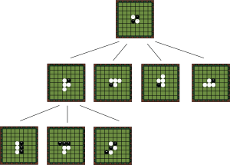
Game Playing
Why study game playing in AI?
Games are intelligent activities
It is very easy to measure success or failure
Does not require large amounts of knowledge
They were thought to be solvable by straightforward search from the starting state to a winning position

Slide 5
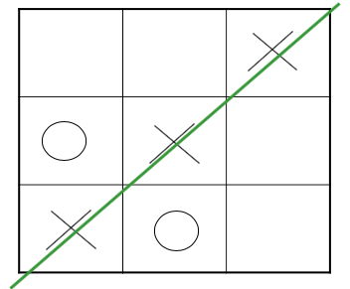
Game Playing (Adversarial Search)
Until now we have often assumed the situation is not going to change whilst we search
Shortest route between two towns
The same goal board of 8-puzzle
Game playing is not like this
Not sure of the state after your opponents move
Goal of your opponent is to prevent your goal, and vice versa
Agent’s goals are conflict, blind search won’t be helpful
giving rise to adversarial search

Slide 6
Game Playing - Minimax
An opponent tries to prevent your win at every move
1944 - John von Neumann
A search method (Minimax)
maximise your position whilst minimising your opponent’s
Utility is an abstract measuring the amount of satisfaction you receive from something
We need a method of measuring how good a position is
Often called a utility function
Initially this will be a value that describes our position exactly

Slide 7
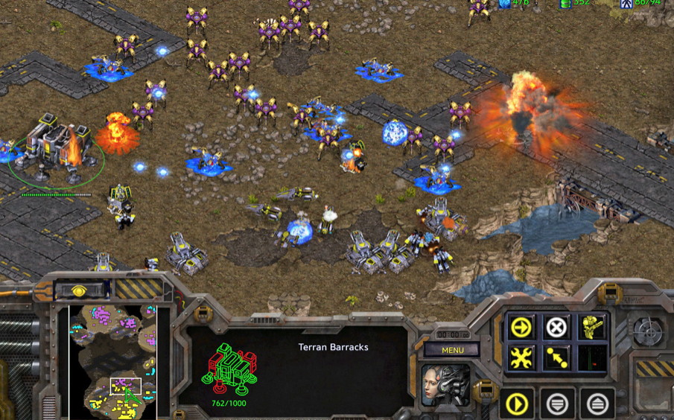
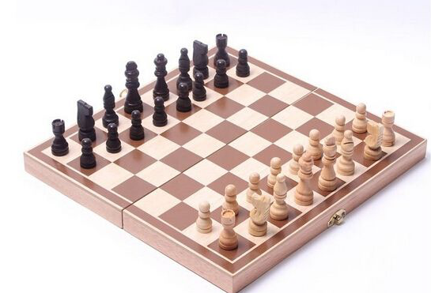
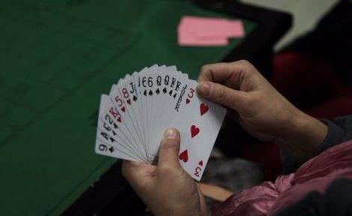
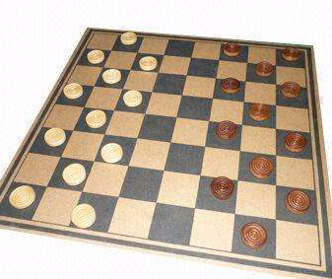
Zero-sum games
Fully observable environments (perfect information) in which two agents act attend
Utility values at the end of the game are always equal or opposite. (0+1, 1+0, or ½+½, total payoff is the same )
For example, if one player wins a game, the other player necessarily loses.
This opposition between the agents’ utility functions makes the situation adversarial.
Notes:
Starcraft， Draw state

Slide 8
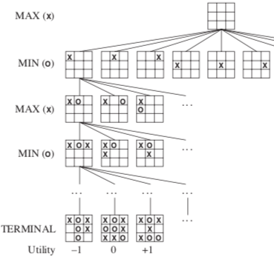
Components of Game Search
A game can be defined as a kind of search problem with the following components :
The initial state: board position, indication of whose move it is
A set of operators: define the legal moves that a player can make
A terminal test: determines when the game is over (terminal states)
A utility (payoff) function: gives a numeric value for the outcome (terminal state) of a game (chess: +1,0, 1/2) ?

Slide 9
Game Playing - Minimax
In discussion of minimax
two players “MAX” and “MIN”
utility function (minimax value) of a node: the utility of (for MAX) being in the corresponding state (larger values are better for “MAX”, vice versa)
MAX: take the best move for MAX
Next state: the one with the highest utility, i.e. the maximum of its children in the search tree
MIN: take the best move for MIN (the worst for MAX)
Next state: the one with the lowest utility i.e. the minimum of its children in the search tree

Slide 10
Assume we can generate the full search tree
The idea is computer wants to force the opponent to lose, and maximise its own chance of winning
Of course for larger problem it’s not possible to draw the entire tree
MAX
1
A
Game starts with computer making the first move
= agent
We know absolutely who will win following a branch
= opponent
Then the opponent makes the next move
MIN
1
B
-3
C
MAX
4
D
1
E
2
F
-3
G
= terminal positions
4
-5
-5
1
-7
2
-3
-8
Assume positive: computer wins
Values are propagated back up through the tree based on whose turn it is and whether they are trying to maximise or minimise at the point
Now we can decide who win the game
Notes:
-8 means the agent lose badly, while 4 means the agent wins
Max prefer to move to a state of maximum value, whereas Min prefers a state of minimum value

Slide 11
Now the computer is able to play a perfect game. At each move it’ll move to a state of the highest value.
Question: who will win this game, if both players play a perfect game?
MAX
1
A
agent
opponent
B
C
MIN
1
-3
MAX
4
D
1
E
2
F
-3
G
terminal positions
4
-5
-5
1
-7
2
-3
-8
Notes:
Positive: MAX (client) wins
Negative: MIN (opponent) wins

Slide 12
Game Playing - Minimax
Nim
Start with a pile of tokens, at each move the player must divide the tokens into two non-empty, non-equal piles
Starting with 7 tokens, draw the complete search tree
Assume that a utility function of
0 = a win for MIN
1 = a win for MAX
+
+
+

Slide 13
7
6-1
5-2
4-3
5-1-1
4-2-1
3-2-2
3-3-1
4-1-1-1
3-2-1-1
2-2-2-1
3-1-1-1-1
2-2-1-1-1
2-1-1-1-1-1

Slide 14
1
7
MIN
1
1
1
MAX
6-1
5-2
4-3
0
1
0
1
MIN
5-1-1
4-2-1
3-2-2
3-3-1
1
0
0
MAX
4-1-1-1
3-2-1-1
2-2-2-1
MIN
0
1
3-1-1-1-1
2-2-1-1-1
MAX
0
2-1-1-1-1-1
Notes:
Who will win?
http://www.dotsphinx.com/games/nim/
http://www.archimedes-lab.org/game_nim/play_nim_game.html

Slide 15
Game Playing - Minimax
Efficiency of the search
Game trees are very big
Evaluation of positions is time-consuming
How can we reduce the number of nodes to be evaluated?
alpha-beta pruning based on minimax, Deep Blue
Better estimation of utility values (possibility of winning), i.e. heuristic, ANN, etc.

Slide 16
Game Playing – Alpha-beta Pruning
Pruning allow us to ignore portions of the search tree that make no difference to the final choice
The number of nodes grow exponentially,
It is possible to compute the correct minimax decision without looking at every node in the game tree
Use the idea of pruning to eliminate large parts of the tree from consideration

Slide 17
A
STOP! What else can
you deduce now!?
STOP! What else can
you deduce now!?
MAX
STOP! What else can
you deduce now!?
<=6
B
C
MIN
On discovering util( D ) = 6
we know that util( B ) <= 6
6
D
>=8
E
MAX
On discovering util( J ) = 8
we know that util( E ) >= 8
H
I
J
K
Can stop expansion of E as best play will not go via E
Value of K is irrelevant – prune it!
6
5
8
= agent
= opponent

Slide 18
MAX
>=6
A
6
B
<=2
C
MIN
6
D
>=8
E
2
F
G
MAX
H
I
J
K
L
M
6
5
8
2
1
= agent
= opponent

Slide 19
MAX
>=6
A
6
B
2
C
MIN
6
D
>=8
E
2
F
G
MAX
H
I
J
K
L
M
6
5
8
2
1
= agent
= opponent

Slide 20
Alpha-beta Pruning
MAX
6
A
6
B
2
C
beta cutoff
MIN
6
D
>=8
E
alpha cutoff
F
G
2
MAX
H
I
J
K
L
M
6
5
8
2
1
= agent
= opponent

Slide 21
Game Playing - Alpha-beta Pruning
If this is done well then alpha-beta search can effectively double the depth of search tree that is searchable in a given time
Effectively reduces the branching factor in chess from about 30 to about 8
This is an enormous improvement!
These bounds are stored in terms of two parameters
alpha α: α values are stored with each MAX node
the highest-value we have found so far at any choice point along the path of MAX
beta β: values are stored with each MIN node
the lowest-value we have found so far at any choice point along the path of MIN

Slide 22
Alpha-beta Pruning
MAX
6
A
beta pruning as β(C) < α(A)
β = 6
B
2
C
MIN
alpha pruning as α(E) > β(B)
6
D
α = 8
E
F
2
G
MAX
H
I
J
K
L
M
6
5
8
2
1
= agent
= opponent

Slide 23
Game Playing - Alpha-beta Pruning
If we were doing BFS, would you still be able to prune nodes in this fashion?
NO! Because the pruning on node D is made by evaluating the tree underneath D
This form of pruning relies on doing a DFS
To maximise pruning: first expand the best children
cannot know which ones are really best
use heuristics for the “best-first” ordering
Heuristic evaluation function allow us to approximate the true utility of a state without doing a complete search.

Slide 24
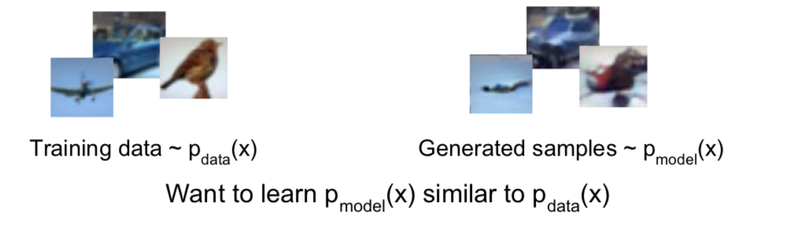
Minimax Usage - Generative adversarial network
Problem: Generative Model
Given training data, generate new samples from same distribution

Slide 25
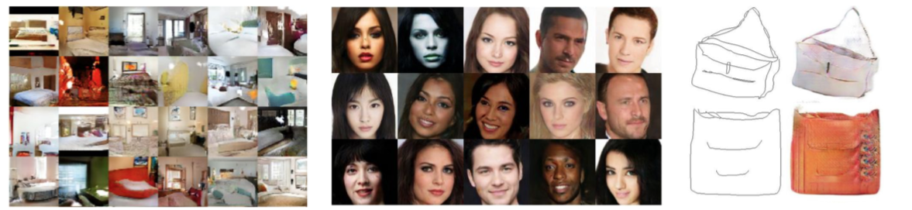
Minimax usage - Generative adversarial network
Why Generative Model?
Generative models of time-series data can be used for simulation and planning
Training generative models can also enable inference of latent representations that can be useful as general features

Slide 26
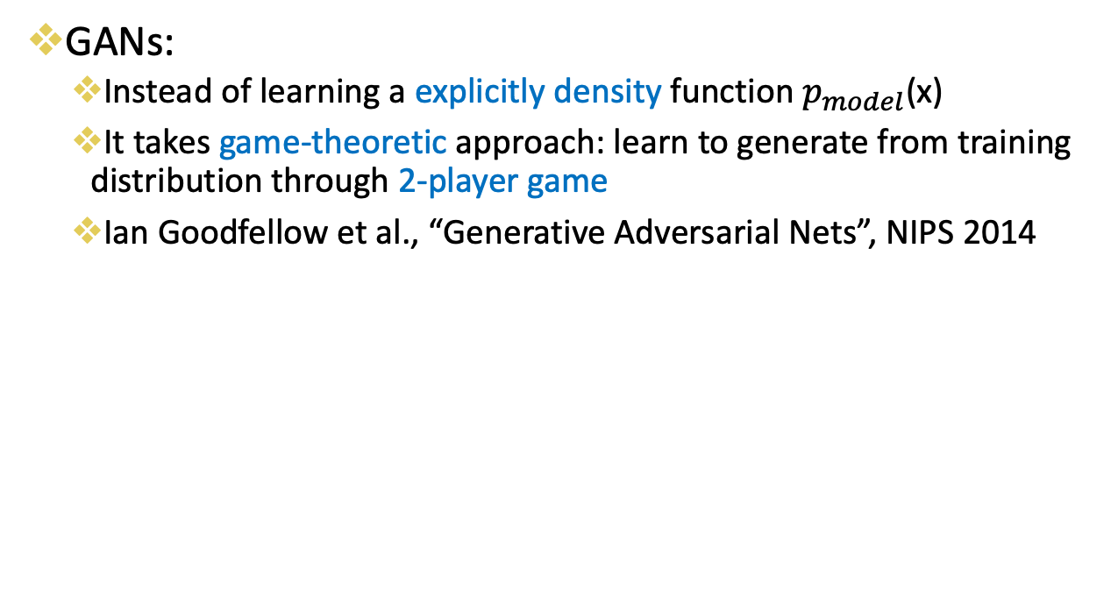
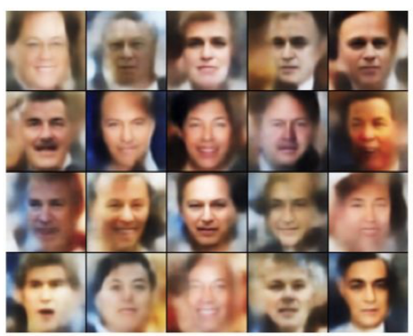
Minimax usage - Generative adversarial network

Slide 27
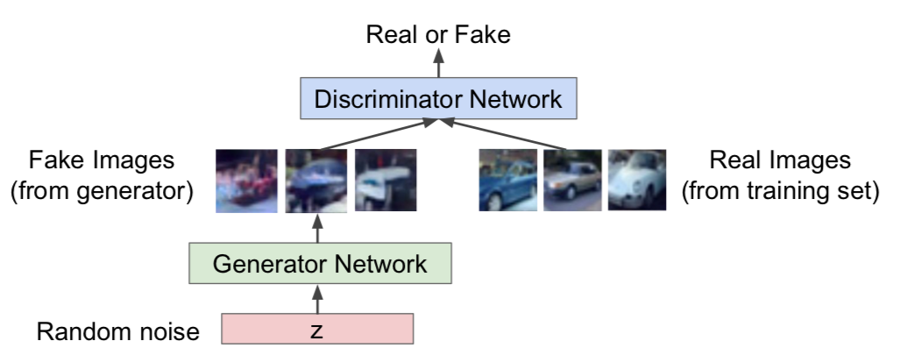
Minimax Usage - Generative adversarial network
Training GANs: Two-player game
Generator network: try to fool the discriminator by generating real-looking images
Discriminator network: try to distinguish between real and fake images

Slide 28
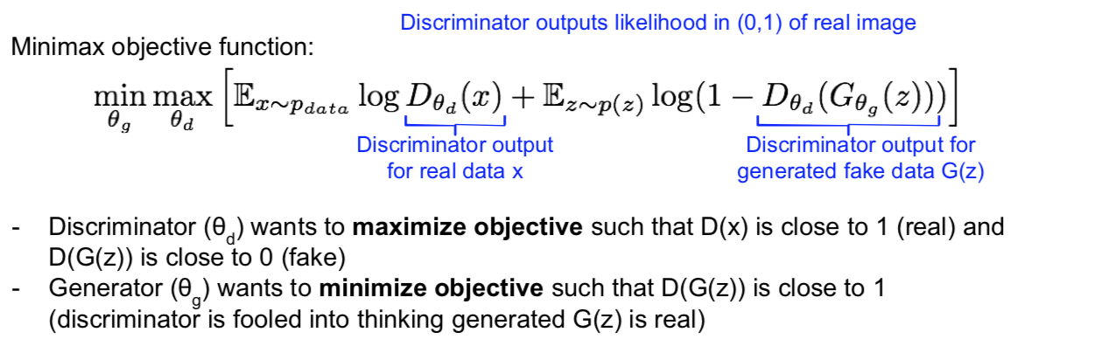
Minimax Usage - Generative adversarial network
Training GANs: Two-player game
Generator network: try to fool the discriminator by generating real-looking images
Discriminator network: try to distinguish between real and fake images
Train jointly in minimax game

Slide 29
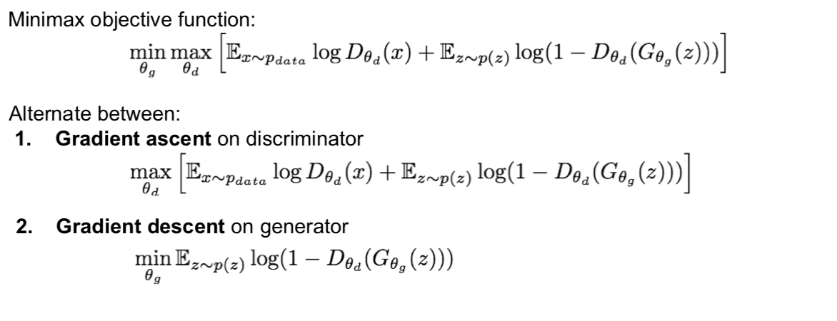
Minimax usage - Generative adversarial network

Slide 30
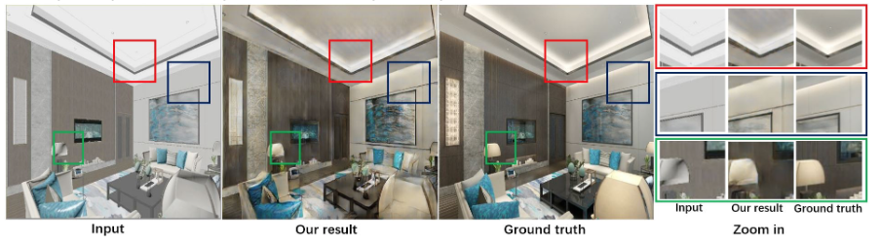
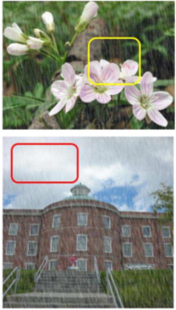
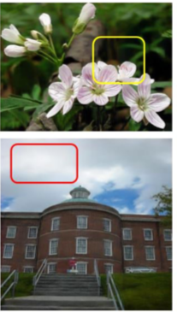

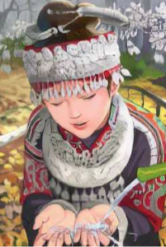
Notes:
Capsule Based Image Synthesis for Interior Design Effect Rendering

Slide 31
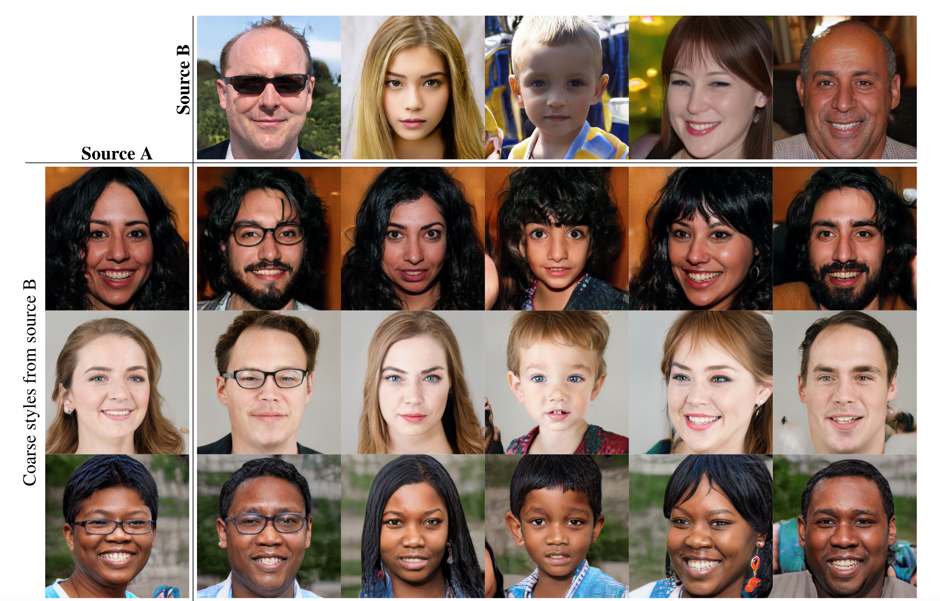

Slide 32
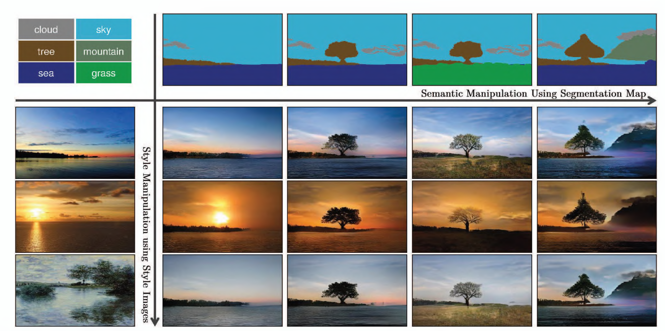

Slide 33
Summary – game playing
Definitions of Game and adversarial search
Techniques
Minimax
Alpha-beta pruning
Game classifications
Further reading: AIMA Adversarial search( 5.1-5.3)

